Slide 1
Financial Risk Management
Members:
Kamran Madatov, Bao Thai, John Mitton
Mentor:
Ted Ahn
Clients:
Wells Fargo
Saint Louis University - Capstone I

Slide 2

General Overview
Project Goal
What is Risk Assessment
Functionality
Design of Application
Web Crawler
Monte Carlo
Project Timeline
Challenges
Responsibilities
Saint Louis University - Capstone I

Slide 3
Our Goal
The objective of this project is to help investors make appropriate decisions with their portfolio to reduce loss when holding, buying, and selling investments.
A mobile application will be created to track listed investments and inform the user based on news, history of stock prices, trend volume, social media, and market stock exchange.
By using statistical data and probability calculation, we would like to ensure accuracy of estimates and allow users to be more informed on changes with a stock.
Saint Louis University - Capstone I

Slide 4
Financial risk assessment
To estimate and predict changes with particular investments due to statistical data or news information that would be essential to the outcome of investments
Variable at Risk
Statistical method to measure and quantify level of risk of particular investment opportunities
Saint Louis University - Capstone I

Slide 5
VaR Applications
Determine the probability and rate of a stock’s growth for a certain time period
Manage an aggregation of portfolio performance for an investment firm
Can also be applied across different markets besides stocks (real estates, etc.)
Saint Louis University - Capstone I

Slide 6
Design and Functionality
Calculate and model the chances of stocks declining or rising from historical data
Using Monte Carlo
Web crawler to pull any stock information related data
Update any users with certain stocks in their portfolio
Notify users of any high risk or severity of certain stocks
Goal is to prevent as little lost as possible
Saint Louis University - Capstone I

Slide 7
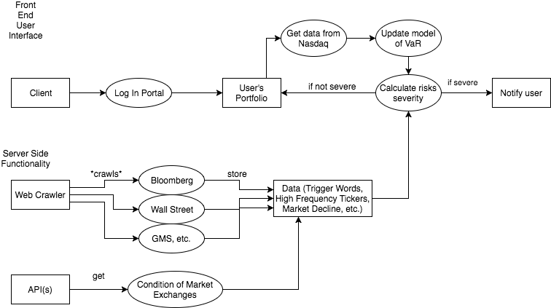
Functionality Diagram
Saint Louis University - Capstone I

Slide 8
Front End and Back End
Full Stack (HTML, PHP, CSS)/Flash(Python) for Web Page, Android Dev (Java)
Either some sort of Web application or mobile application for the UI
HTML and CS for UI design and aesthetics of website, can look into Flask as well
PHP will be responsible for back-end application layer for database and user communication
The Back End consists of a Web-crawler and the Monte Carlo Simulation
Run using Spark and Python
Hosted on AWS due to computing needs
SQL database - for a more automated database and information processing than NoSQL
Saint Louis University - Capstone I

Slide 9
Web-Crawler
Will be running on EC2 instances on AWS, will run continuously
Python (3.0+)
Scrappy - web-crawler library with python
For more libraries and functionalities
And cross-platform for data and information processing
Much easier and less complexity for high level programming as well as a scripting language to run back-end data aggregation
Saint Louis University - Capstone I

Slide 10
Monte Carlo Modeling
Generate random samples and trials that follow constraints of instance
Preferably 100+ trials
Divide into short term and long term models
Take an average of all trials
Use the average to determine risks
Saint Louis University - Capstone I

Slide 11
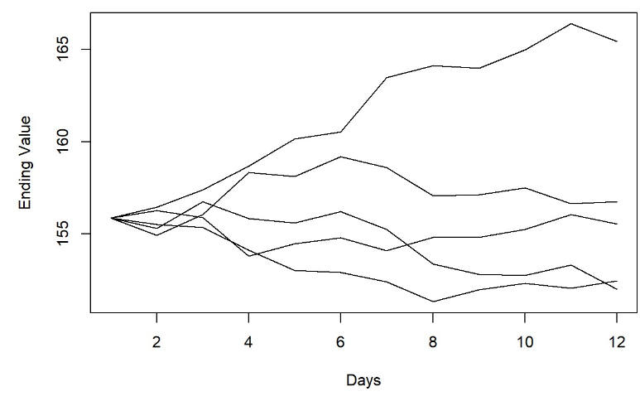
Simulation Example
Saint Louis University - Capstone I

Slide 12
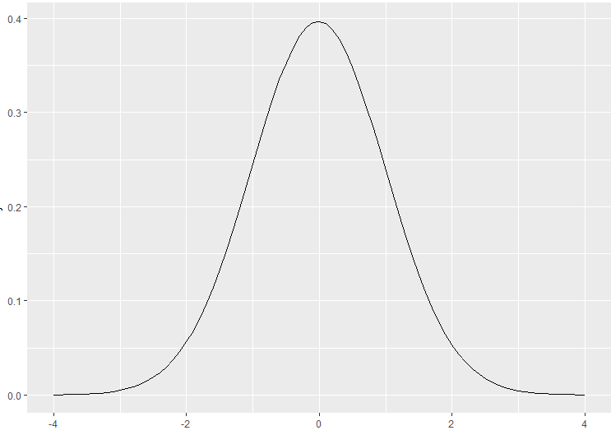
Normal Random Variable
Saint Louis University - Capstone I

Slide 13
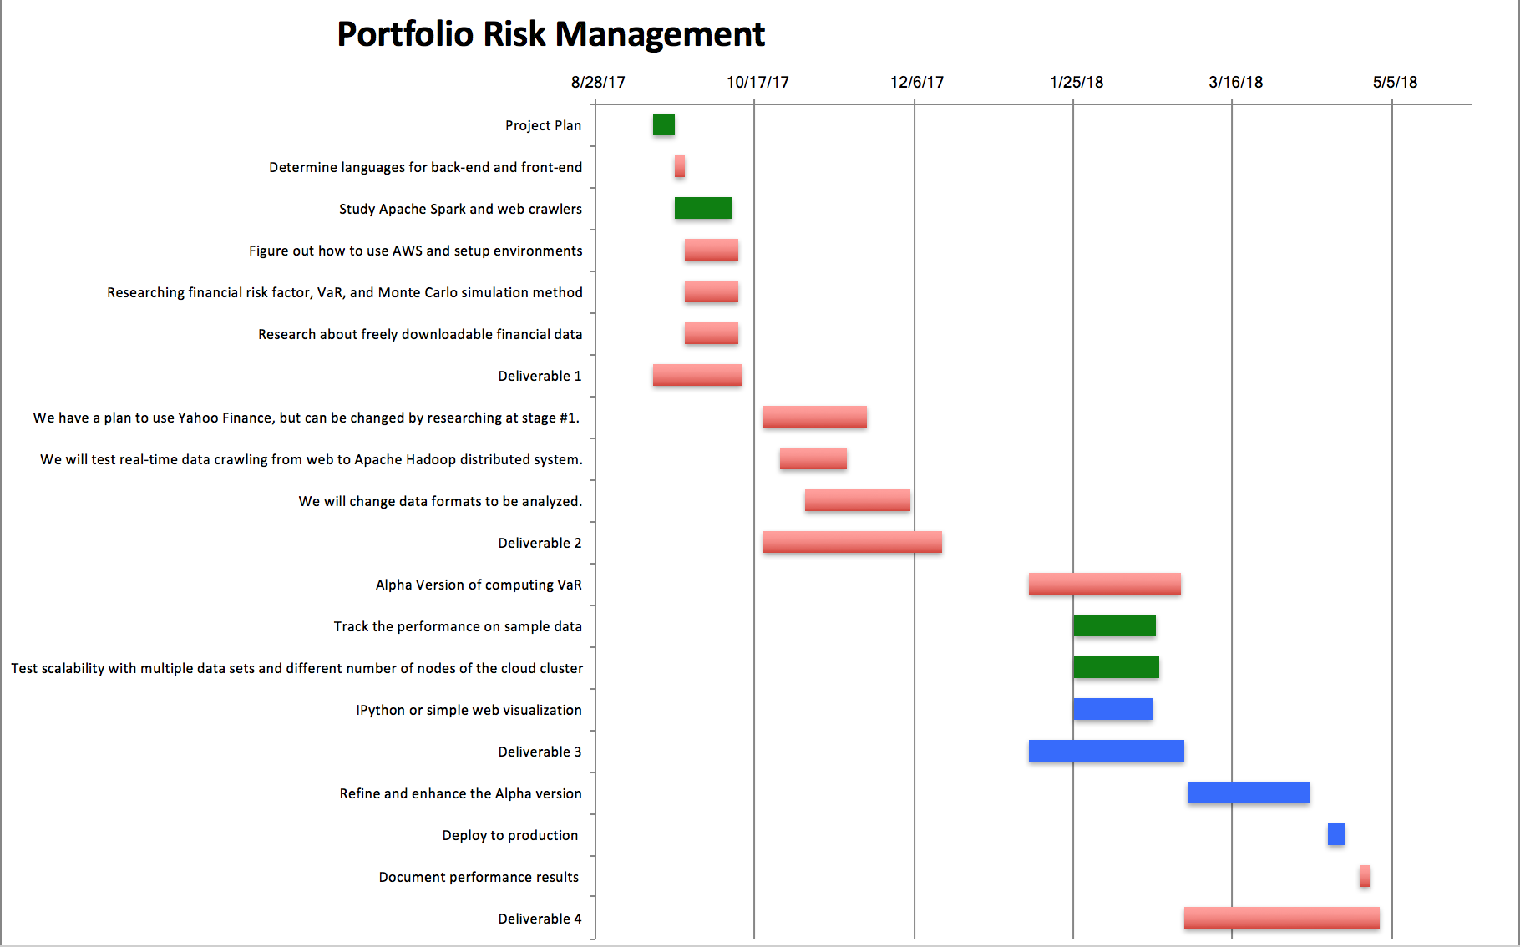
Project Timeline
We are here

Slide 14
Challenges
Development practices and focus
Agile methodology - how to best stay on this method
Balancing design as well as research to reduce repetition
Getting into development
Still gray area on the overall development, will continuously research as we are designing
Saint Louis University - Capstone I

Slide 15
Responsibility and Future
Developments
Accomplished
Bao - Python code development for web-crawling application to obtain historical pricing information and articles search
John - Create a small sample simulation in R
Kamran - Research and run instances of Apache Spark/Hadoop/Big Data on AWS
Future
Bao - Research on how to analyze articles that reflects the outcoming of particular stocks
Kamran - Develop scripts to get API technical informations from Google/Yahoo Finance
Volumes and current prices, as well as market exchange
John - Transfer simulation to Python and expand the number of trials
Data management and storing
Saint Louis University - Capstone I

